Slide 1

Nosferatu
We will Hash Slinging Slash your electric bill
By: Gunnar Boehm, Dan Cardin, Joe Gorse, Connor Igo, Chris Holtsnider,
Advisor: John Kimani
2015 EECE Capstone
Notes:
Connor

Slide 2
Introduction
Nosferatu is an energy efficient, convenient new way to control your home lighting. Bringing Wi-Fi and motion sensors to your light switches allows you to set schedules and rules to manage your home lighting, as well as save money, energy and time.
Notes:
Connor

Slide 3
Design Concept
Provide an easy to use solution for home lighting
Provide an easy and effective way to save energy in homes
Keep the design open to be integrated with other smart devices
Notes:
Connor

Slide 4
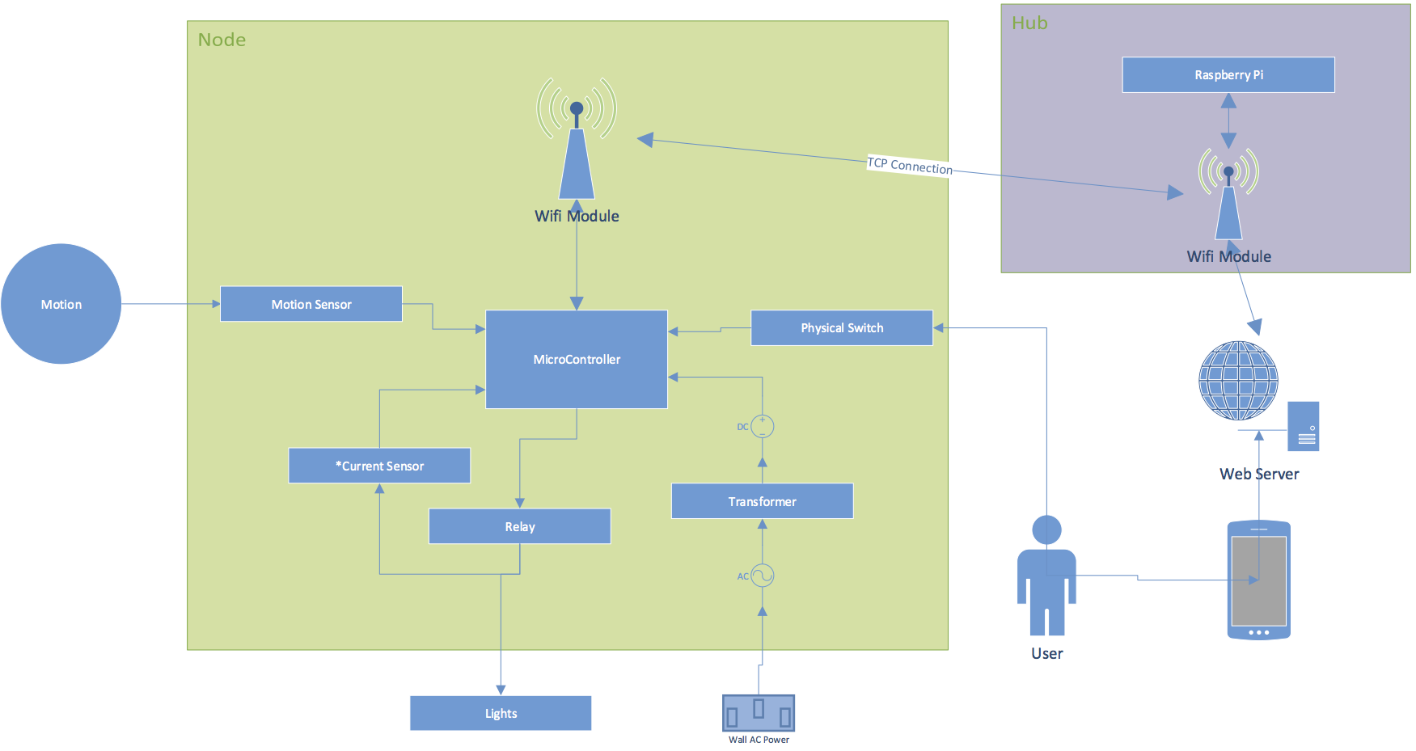
Hardware Layout
Notes:
Chris
Need to update this chart: Server is on Rpi, not external. Joe doesn’t have Visio so can someone else do that?

Slide 5
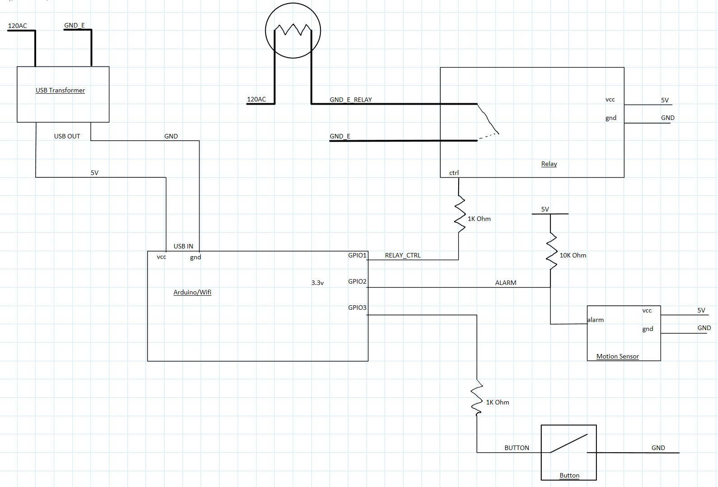
Hardware Schematic
Notes:
Chris

Slide 6
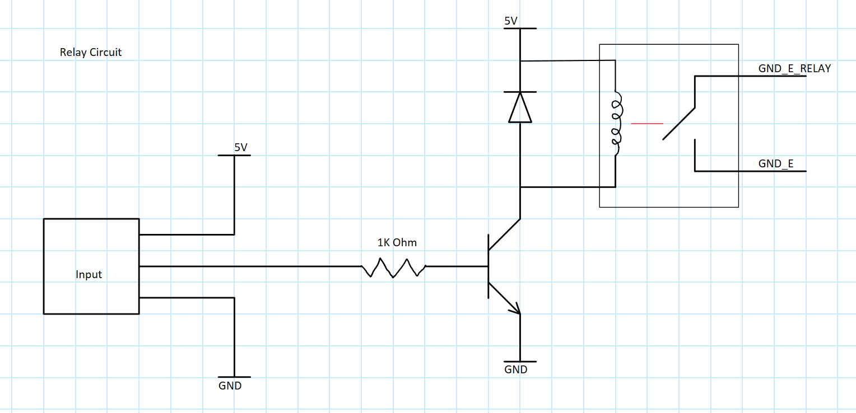
Relay Schematic
Notes:
Chris

Slide 7
Firmware
Developed with Arduino IDE
C/C++ Based
Built in WiFi to board utilize multiple user libraries
Digital control over all I/O such as:
Relay to control lights
Motion Control
Manual Control
Built in file system
Used to store files for backup, or hosting more advanced forms
LUA and Micro Python interpreters for scripting
Notes:
Connor

Slide 8
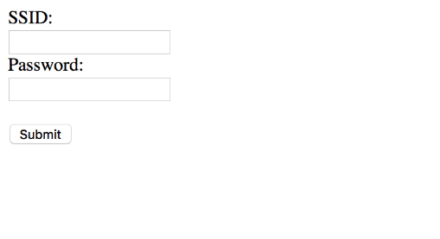
Initial User Setup
If Node is not paired with a server, a basic webpage will be hosted for the user to input the SSID and Password of the server’s connection point
Notes:
Joe

Slide 9
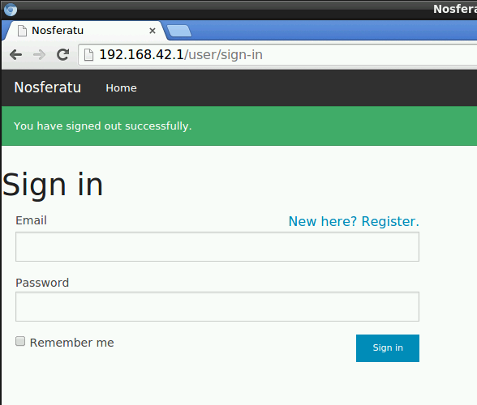
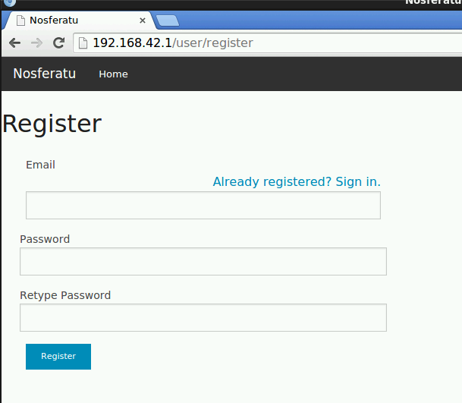
Front End (UI)
Notes:
Dan

Slide 10
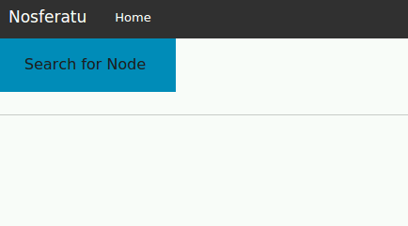
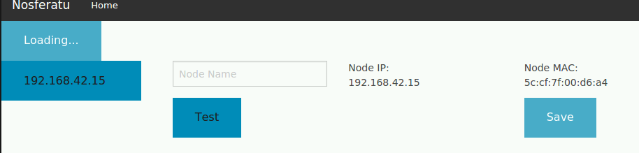
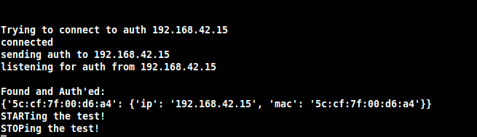
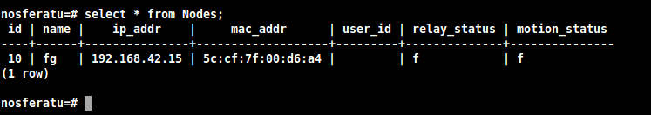
Frontend (UI)
continued…
Notes:
Joe

Slide 11
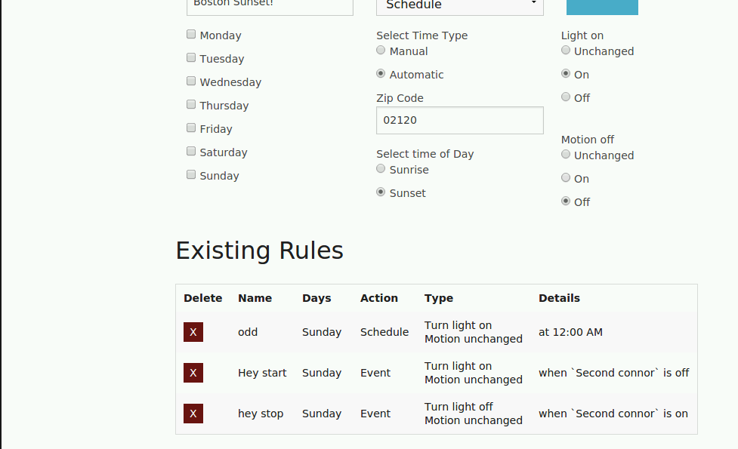
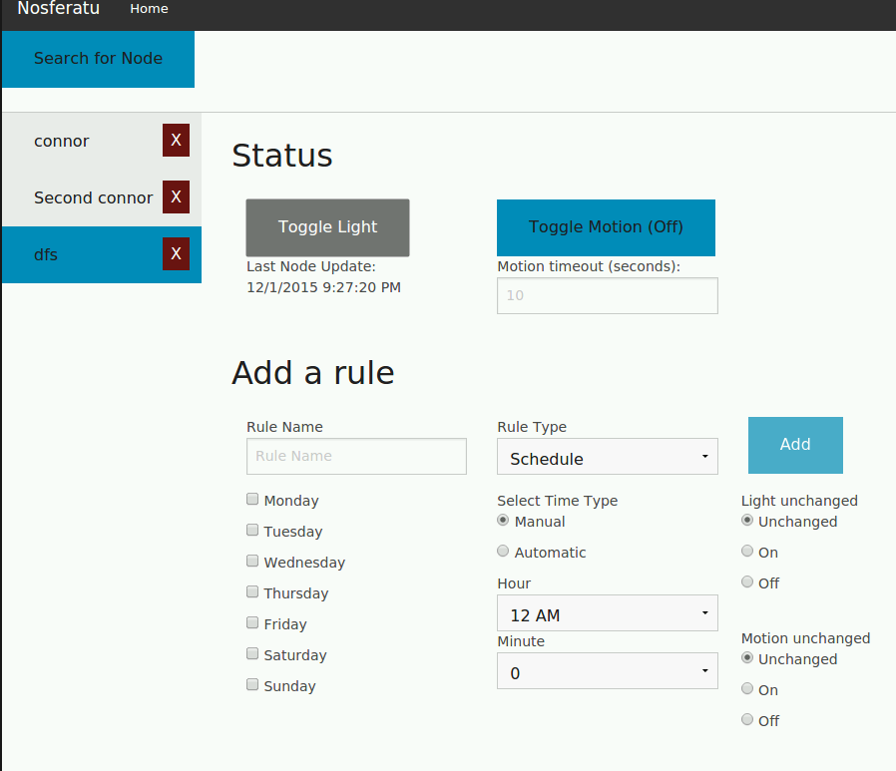

Frontend (UI)
continued…
Notes:
Dan

Slide 12
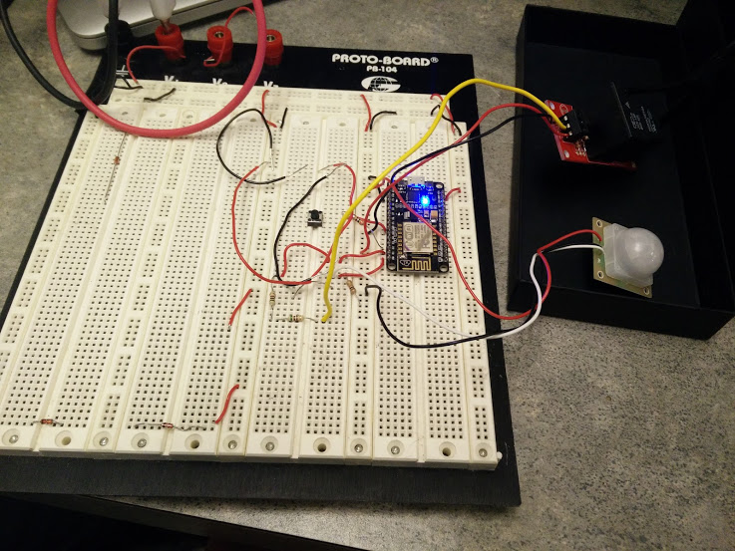
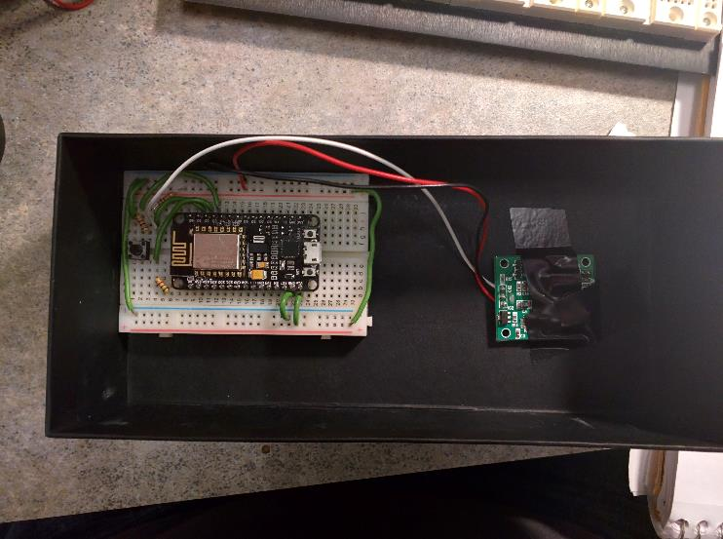
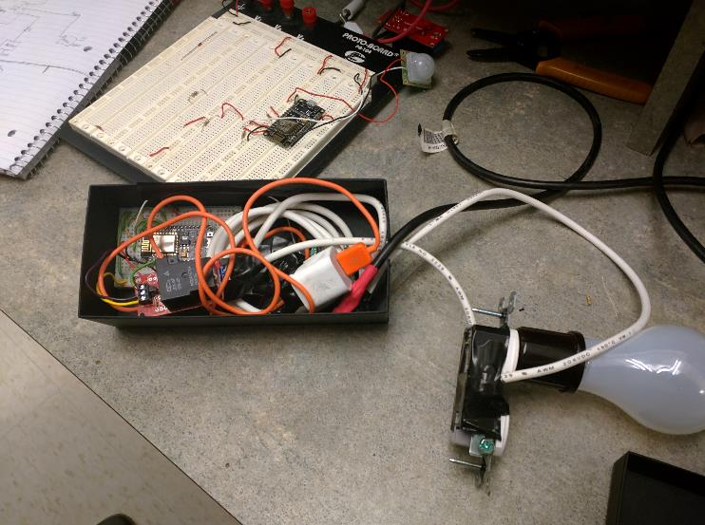
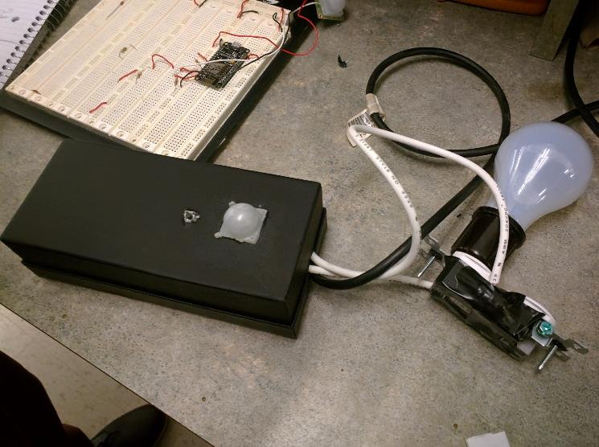
Build Process
Notes:
Gunnar

Slide 13
Changes from Proposal
Switched from Arduino Pro Mini with an ESP8266 module to a NodeMCU
Developed with Celery, then switched to an in-memory SQLite database
Notes:
Gunnar
Newer MCU offered more reliable communication with server. Also offered additional functionality such as Lua and MicroPython interpretors.
Celery was slow to develop with and didn’t work reliably.

Slide 14
Future Development
More advanced schedules/rules
More advanced UI on the Node
Front end could easily hook into 3rd party home automation
like the Nest thermostat!
Utilize deep-sleep mode on the microcontroller
Dan is not a UI designer, all the UI clearly needs work!
Notes:
Gunnar
Such as rules that control more than 1 light
The login page for the Node is clearly basic and could be much more interactive
Obvious
To lower our power consumption
obvious

Slide 15
Questions?
Thank you to our advisor, John Kimani, for your guidance and support

